Slide 1
PICTURE COMPOSITION
A kind of essay topic in which the student is given a picture to interpret.

Slide 2
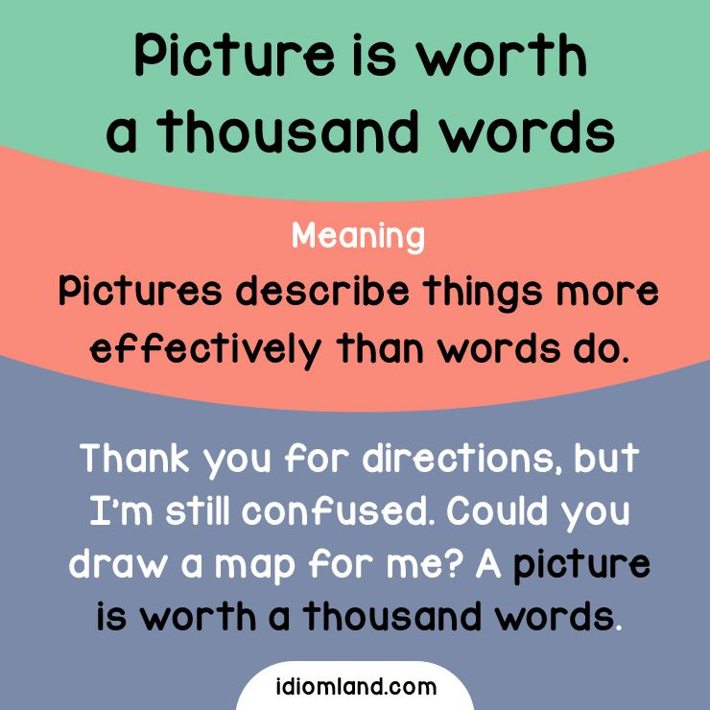

Slide 3
Fundamentals: A picture is worth a thousand words
Every picture contains a story
The picture helps us focus on the key information provided in the illustration.
Decode it, be observant to the mood of the picture, the ambience and the background and pay attention to every hint given.
There should be a direct connection between the picture and the composition.
Do not use the word “picture”.
Keep the word limit to 300-350 words.

Slide 4
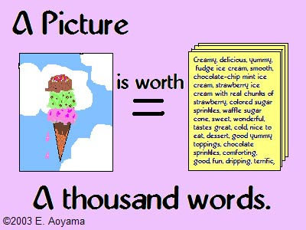

Slide 5
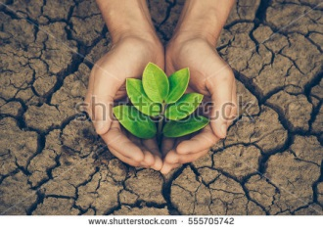

Slide 6
HOPE
Every day number of trees disappear from the face of the earth.(Importance of trees)
It's high time now, that we stop this mean destruction, before we forget the colour green.
The forest cover of the whole world has drastically depleted over a period of time owing to the human needs and activities.
Water scarcity is either the lack of enough water (quantity) or lack of access to safe water (quality).
Water is the most precious gift to the humanity by the nature. Life on the earth is possible only because of water. Three-fourth surface of the earth is covered by the water even after people are suffering from water scarcity in many regions of the India and other countries. Difficulties faced by the people in various regions because of water scarcity teach us to conserve and save water in order to protect the water environment, save life and save world.
Why should we take efforts now in order to save Earth in future? Very few people understand that it is important to change their lifestyle now in order to see the results of these changes in a few decades. Doubtless, you will not grow a big forest in a year. You can plant a small tree but it will grow to its proper height only in ten or fifteen years.
Trees are as valuable as gold that’s why they are called as “Green Gold” on the earth. They are the real source of our health as well as wealth because they give us oxygen, cool air, fruits, spices, vegetables, medicines, water, wood, furniture, shadow, fuel to burn, houses, fodder to animals and other useful things.
Water:conservation. Dependency on rains

Slide 7
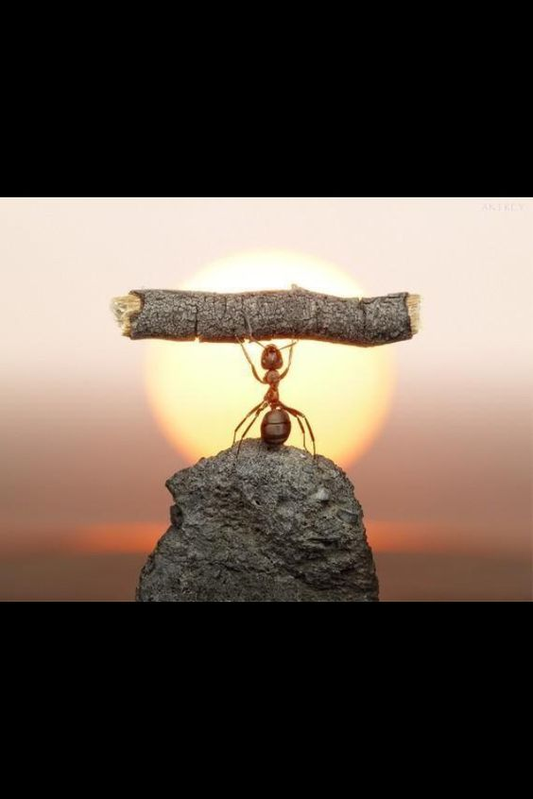

Slide 8
DEVELOP YOUR ESSAY
What do we see?
Where is the ant standing? What is it carrying?
What are the five things you know about ants?
What can we learn from the ants?
Does it look like a statue? What does it represent?
What do ants remind us of?
What are the life lessons that we learn from an ant?

Slide 9
A Statue of Labour: The Ant
Ants are social insects that live in colonies . Ants may seem small and insignificant, but consider this: ants are capable of carrying 50 times their own weight and up to 30 times their own volume.
Basically one can learn the virtues of team work, hard work, community bonding from the ants. But the most important lesson you can learn from ants, is to punch above your own weight, do not get worried by your circumstances and what you are, try to go above it.

